Slide 1
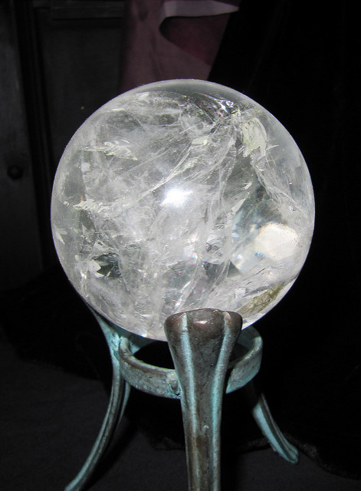
The Crystal Ball of Civil & Building Construction Estimating
The Pacific Club, Honolulu, Hawaii
November 3, 2016
Scott Jennings, P.E.
SJ Construction Consulting, LLC
Jim Bauckham
Nordic PCL Construction, Inc.

Slide 2
INTRODUCTIONS
Scott Jennings, P.E.
SJ Construction Consulting, LLC
25 years in heavy/civil construction
12 of those years estimating
Hawaii, Pacific Northwest, Southwest, & mid-Atlantic
Water/wastewater, utilities, grading, road/bridge, & structural concrete
Jim Bauckham
Nordic PCL Construction, Inc.
26 years construction experience
8 of those years in estimating
Hawaiian Islands
Heavy civil, structural concrete & building

Slide 3
What is Estimating ?
Estimator. Noun. [es-ti-may-ter] Someone who does precision guesswork based on unreliable data provided by those with questionable knowledge.
See also Wizard, Magician.

Slide 4
Estimating is Art & Science
Art
Preliminary drawings & specifications
Schedule
Preliminary budget
What will the market take?
What is my estimate like versus what will happen in the field?

Slide 5
Estimating is Art & Science
Science
Complete Drawings & Specs
Details
Quantities
Labor Rates
Material Costs (Today)

Slide 7
Construction Manager
Know the work?
Post office or problem solver?
Engineer
History of gitty up?
Construction savvy?

Slide 8
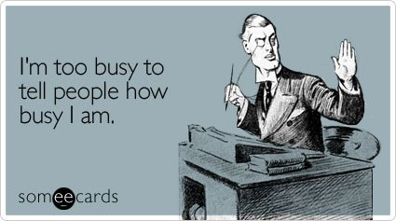
Owner
Timely payment?
Real answers at bid time.
Fair, but firm.
Contractor
Material advantage
Labor competition
Extra cost to steal personnel - $2/hr?
Mandatory local labor
OT premiums
Mistakes
Schedule
Backlog

Slide 10
Cost Control
Establish preliminary budgets
Work as a team
Design to the budget
Can’t control the market

Slide 11
Fallacies
Cost will go down over time.
Contractor wants to “make it up in change orders”.
Contractors carry a large “contingency” for changes .

Slide 12
Thank you…
Scott Jennings, P.E.
SJ Construction Consulting, LLC
Jim Bauckham
Nordic PCL Construction, Inc.

